Slide 1
Practical Challenges with Cross-signed Certs as a signature algorithm transition mechanism in TLS 1.3
Panos Kampanakis Viktor Dukhovni
AWS OpenSSL

Slide 2
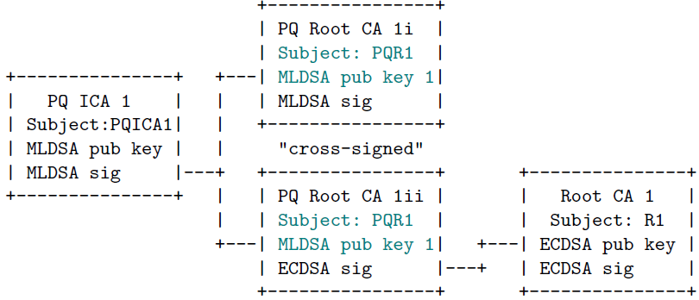
Cross-signing as a transition mechanism
Cross-signed Root CAs (as also used in the RSA to ECDSA transition)
Why?
Clients may support and advertise PQ Sigs before receiving PQ Roots in their Trust Stores.

Slide 3
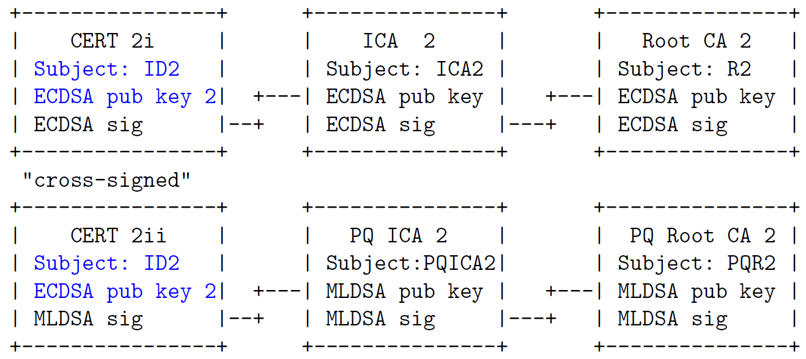
Cross-signing as a transition mechanism
Cross-signed Leaf Certs
( This transition approach is proposed slightly differently as one, large, combined leaf cert in Chrome’s PQ PKI Roadmap (Stage 3). To be discussed later. )
Why?
PKI / CAs can start supporting PQ Sigs through existing automation without any upgrades to clients and servers.
PQ-only clients can start supporting PQ issuers.
Downgrades are not possible against PQ-CA-only clients.

Slide 4


TLS stacks investigated
-tls
(with )
How the authenticating party picks the cert (and chain) to send to peer
Go down the configured certificates and
Match leaf cert
  public key algorithm against ClientHello sigAlgs
Notes:
OpenSSL does not filter a flat set of certificates by SNI, but the SNI callback allows the server to choose a set of candidate certificate chains, and then a match is found a mutually supported sigalg .

Slide 5
Challenges with cert chain selection
Inadvertent failures
Reminder: Today, typically only the first configured cert chain with a leaf PK algorithm matching the client sigAlgs is picked.
A client that supports PQ sigAlgs, but does not have PQ Root CA 1i in its Trust Store may fail to connect
A client that does not support PQ sigAlgs/sigAlgsCert may fail to connect.
Notes:
The Cross Signed Roots work today because we configure a chain with all stuff in it (PQ ICA 1 and PQ Root CA 1ii) so the client gets all CAs and builds the chain based on what it has, but if we configured two chains, the chain selection logic could lead to conn failures. The sky is not falling, but the cert selection does not give us the granularity and we are wasting KB since the PQ Root CA 1ii now is 3KB or more.

Slide 6
Challenges with the cert chain selection sigAlgs
Reminder: Today, typically only the leaf cert PK algorithm is matched against the relying party’s sigAls.
Discussion
Should the client advertised sigAlgs be matched against the cert chain PKs and Sigs?
  In principle as per RFC8446 and RFC9846?
  In reality,
    does the TLS stack know what the X.509/ASN.1/Cert stack supports?
  Should the match only be for the leaf cert PK and Sig?
  Does it even matter?
Should the client consult its Trust Store before advertising support for sigAlgs XYZ?
A client that does not advertise ECDSA sigAlgs may receive an ECDSA signed ICA.
Notes:
From RFC8446 and RFC9846
[…] If no "signature_algorithms_cert" extension is
present, then the "signature_algorithms" extension also applies to
signatures appearing in certificates. […]

Slide 7
(General) Solution
Relying party signals Trusted Roots. Authenticating Party honors them.
Good old certificate_authorities extension in TLS 1.3
  Caveats
    What if I have lots of Roots? Is it a DoS vector for the server?
    Very limited support today.
IETF draft-ietf-tls-trust-anchor-ids (for MTC certs)
IETF draft-ietf-tls-cert-abridge (now parked)
Client Server
ClientHello
+ key_share
+ [...] -------->
+ certificate_authorities
ServerHello
<-------- + Certificates
+ [...]
[ ... ]
Notes:
> Caveat: What if I have lots of Roots?
100 Roots, for example, of 20 characters each, means >2KB larger ClientHello.
> Caveat: Do I send PQCA1ii to a client advertising certificate_authorities=PQR1 ?
The point here is that the extension does not distinguish between Cross Signed Root unless we make further assumptions.

Slide 8
Common Current Approach (for cross-signed Roots)
Authenticating Party always sends cross-signed PQ Root
Common traditional cross-signing practice of the past.
  e.g. Amazon Root CA 3 (ECDSA P256) and
  Amazon Root CA 4 (ECDSA P384) signed by
  Starfield Services Root CA - G2 (RSA 2048)
Caveat: Cross-signed PQ Root CA 1ii is relatively large and would not be of use to upgraded Trust Store clients.
A legacy Trust Store client verifies with traditional Root CA 1.
An upgraded Trust Store client verifies with PQ Root CA 1i.
Notes:
https://www.amazontrust.com/repository/
https://www.amazontrust.com/repository/cross-signed-and-externally-operated-subordinate-cas-certificates

Slide 9
Potential Solution (for cross-signed leaf certs)
Stuff the PQ sigs in a non-critical extension in the traditional cert
(as proposed in Chrome’s PQ PKI Roadmap (Stage 3))
Caveats
  Legacy clients get the multiple large PQ sigs without using them.
  Could legacy clients still choke with the extension? (Probably not)
CERT
Extension
Standalone MTC cert with multiple MLDSA Sigs.
A legacy client ignores the non-critical extension.
An upgraded client verifies the PQ Sigs.
Notes:
PQ sigs is the standalone MTC certificate size or PQ signature.

Slide 10
Thank you

